Slide 1



First & Follow and LL(1) Grammar

Slide 2
Parsers
Parsing is classified into two categories,
Top Down Parsing
Bottom-Up Parsing.
Top-Down Parsing is based on Left Most Derivation whereas Bottom Up Parsing is dependent on Reverse Right Most Derivation.

Slide 3
Top-Down Parsing
Top-down parsing can be viewed as the problem of constructing a parse tree for the input string, starting from the root and creating the nodes of the parse tree in preorder (depth-first). Equivalently, top-down parsing can be viewed as finding a leftmost derivation for an input string.

Slide 4

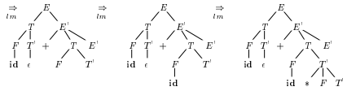
Top-Down Parsing
Example:
E → T E’
E’ → + T E’ | Ɛ
T → F T’
T’ → * F T’ | Ɛ
F → ( E ) | id
Top-down parse for id + id * id

Slide 5
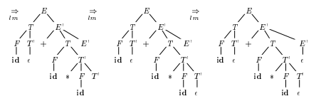
Top-Down Parsing
Example:
E → T E’
E’ → + T E’ | Ɛ
T → F T’
T’ → * F T’ | Ɛ
F → ( E ) | id
Top-down parse for id + id * id

Slide 6
Top-Down Parsing
The process of constructing the parse tree which starts from the root and goes down to the leaf is Top-Down Parsing.
Top-Down Parsers constructs from the Grammar which is free from ambiguity and left recursion.
Top Down Parsers uses leftmost derivation to construct a parse tree.
It allows a grammar which is free from Left Factoring.

Slide 7
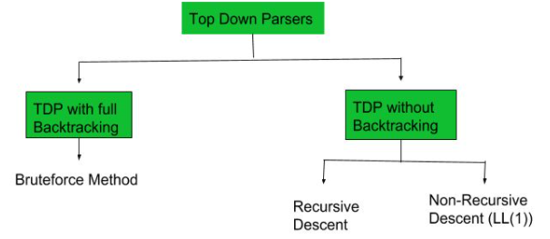
Classification of Top-Down Parsing
With Backtracking:
Brute Force Technique
Without Backtracking:
Recursive Descent Parsing
Predictive Parsing or Non-Recursive Parsing or LL(1) Parsing or Table Driver Parsing

Slide 8
Classification of Top-Down Parsing
Brute Force Technique or Recursive Descent Parsing –
Whenever a Non-terminal spend first time then go with the first alternative and compare with the given I/P String
If matching doesn’t occur then go with the second alternative and compare with the given I/P String.
If matching again not found then go with the alternative and so on.
Moreover, If matching occurs for at least one alternative, then the I/P string is parsed successfully.

Slide 9
Classification of Top-Down Parsing
Recursive Descent Parsing
A recursive-descent parsing program consists of a set of procedures, one for each nonterminal. Execution begins with the procedure for the start symbol, which halts and announces success if its procedure body scans the entire input string.
General recursive-descent may require backtracking; that is, it may require repeated scans over the input. However, backtracking is rarely needed to parse programming language constructs, so backtracking parsers are not seen frequently. Even for situations like natural language parsing, backtracking is not very efficient.

Slide 10

Classification of Top-Down Parsing
Recursive Descent Parsing
Consider the grammar
S→ c A d
A→ a b | a
Construct a parse tree top-down for input string w = c a d
Steps in a top-down parse

Slide 11
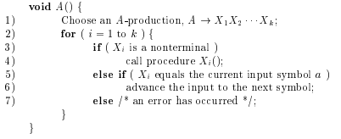
Classification of Top-Down Parsing
A typical procedure for a non terminal in a top-down parser.

Slide 12
Classification of Top-Down Parsing
LL(1) or Table Driver or Predictive Parser –
In LL1, first L stands for Left to Right and second L stands for Left-most Derivation. 1 stands for number of Look Aheads token used by parser while parsing a sentence.
LL(1) parsing is constructed from the grammar which is free from left recursion, common prefix, and ambiguity.
LL(1) parser depends on 1 look ahead symbol to predict the production to expand the parse tree.
This parser is Non-Recursive.

Slide 13
Classification of Top-Down Parsing
LL(1) or Table Driver or Predictive Parser –
In many cases, by carefully writing a grammar, eliminating left recursion from it, and left factoring the resulting grammar, we can obtain a grammar that can be parsed by a recursive-descent parser that needs no backtracking. i.e a predictive parser. To construct a predictive parser, we must know, given the current input symbol a and the nonterminal A→a1|a2|…|an is the unique alternatives of production with a. For example, stmt →if expr then stmt else stmt | while expr do stmt | begin stmt_list end

Slide 14
FIRST & FOLLOW
The construction of both top-down and bottom-up parsers is aided by two functions, FIRST and FOLLOW, associated with a grammar G.
During topdown parsing, FIRST and FOLLOW allow us to choose which production to apply, based on the next input symbol.
During panic-mode error recovery, sets of tokens produced by FOLLOW can be used as synchronizing tokens

Slide 15
FIRST & FOLLOW
The construction of a predictive parser is aided by two functions First and Follow associated with a grammar G.
These functions, FIRST and FOLLOW, allow us to fill in the entries of a predictive parsing table for G.
Sets of tokens yielded by the FOLLOW function can also be used as synchronizing tokens during panic-mode error recovery.

Slide 16
FIRST SET
If α is any string of grammar symbols, let FIRST(α) be the set of terminals that begin the strings derived from a. If a => Ɛ then Ɛ is also in FIRST(α).
To compute FIRST(X) for all grammar symbols X, apply the following rules until no more terminals or Ɛ can be added to any FIRST set.

Slide 17
RULES FOR FIRST SET
If X is terminal, then FIRST(X) is {X}.
If X => Ɛ is a production, then add Ɛ to FIRST(X).
If X is nonterminal and X => Y1 Y2 ... Yk. is a production, then place a in FIRST(X) if for some i, a is in FIRST(Yi), and Ɛ is in all of FIRST(Y1), ... , FIRST(Yi-1); that is, Y1, ... ,Yi-1
=> Ɛ. If Ɛ is in FIRST(Yj) for all j = 1, 2, ... , k, then add Ɛ to FIRST(X).
For example, everything in FIRST(Y1) is surely in FIRST(X). If Y1 does not derive Ɛ, then we add nothing more to FIRST(X), but if Y1 => Ɛ, then we add FIRST(Y2) and so on.

Slide 18
RULES FOR FIRST SET
Now, we can compute FIRST for any string X1X2 . . . Xn as follows. Add to FIRST(X1X2 ... Xn) all the none symbols of FIRST(X1).
Also add the non-Ɛ symbols of FIRST(X2) if e is in FIRST(X1), the non-Ɛ symbols of FIRST(X3) if Ɛ is in both FIRST(X1) and FIRST(X2), and so on. Finally, add Ɛ to FIRST(X1X2 ... Xn) if, for all i, FIRST(Xi) contains Ɛ.

Slide 19
FOLLOW SET
Define FOLLOW(A), for nonterminal A, to be the set of terminals a that can appear immediately to the right of A in some sentential form, that is, the set of terminals a such that there exists a derivation of the form
S => α Aaβ for some α and β. Note that there may, at some time during the derivation, have been symbols between A and a, but if so, they derived Ɛ and disappeared.
If A can be the rightmost symbol in some sentential form, then $, representing the input right end marker, is in FOLLOW(A).

Slide 20
RULES FOR FOLLOW SET
Place $ in FOLLOW(S), where S is the start symbol and $ is the input right end marker.
If there is a production A => α Bβ, then everything in FIRST(β), except for Ɛ, is placed in FOLLOW(B).
If there is a production A => α B, or a production A => α Bβ where FIRST(β) contains Ɛ (i.e., β => Ɛ), then everything in FOLLOW(A) is in FOLLOW(B).

Slide 21
EXAMPLE
FIRST:
FIRST(E) = FIRST(T) = FIRST(F) = {( , id}
FIRST(E’) = {+, Ɛ}
FIRST(T’) = {*, Ɛ}
E => T E’
E’=> + T E’ | Ɛ
T => F T’
T’=> * F T’ | Ɛ
F => ( E ) | id
FOLLOW:
FOLLOW(E) = FOLLOW(E’) = {) , $}
FOLLOW(T) = FOLLOW(T’) = {+, ), $}
FOLLOW(F) = {+, *, ), $}

Slide 22
EXAMPLE
FIRST:
First(S) = {b, d, a}
First(A) = {b, d, Ɛ}
First(B) = {b, Ɛ}
First(D) = {d, Ɛ }
S => A a
A => B D
B => b | Ɛ
D => d | Ɛ
FOLLOW:
Follow(S) = {$}
Follow(A) = {a}
Follow(B) = {d, a}
Follow(D) = {a}

Slide 23
EXAMPLE
S => A a
A => aB /Ad
B => b
C => g
We have,
The given grammar is left recursive.
So, we first remove left recursion from given grammar.

Slide 24
EXAMPLE
After eliminating left recursion, we get the following grammar
S => A
A => aBA’
A’ => dA’ / Ɛ
B => b
C => g
FIRST:
First(S) = First(A) ={ a }
First(A) ={ a }
First(A’) ={ d , Ɛ }
First(B) ={ b }
First(C) ={ g }

Slide 25
EXAMPLE
After eliminating left recursion, we get the following grammar
S => A
A => aBA’
A’ => dA’ / Ɛ
B => b
C => g
FOLLOW:
Follow(S) ={ $ }
Follow(A) = Follow(S) ={ $ }
Follow(A’) = Follow(A) ={ $ }
Follow(B) = {First(A’) – Ɛ } U Follow(A) = { d , $ }
Follow(C) = NA

Slide 26
Transition Diagrams for Predictive Parsers
Transition diagrams are useful for visualizing predictive parsers. To construct the transition diagram from a grammar, first eliminate left recursion and then left factor the grammar. Then, for each nonterminal A,
1. Create an initial and final (return) state.
2. For each production A→ X1X2 … Xk, create a path from the initial to the final state, with edges labeled X1; X2 …. Xk. If A → Ɛ , the path is an edge labeled Ɛ.

Slide 27
Transition Diagrams for Predictive Parsers
Transition diagrams for predictive parsers differ from those for lexical analyzers. Parsers have one diagram for each nonterminal. The labels of edges can be tokens or nonterminals. A transition on a token (terminal) means that we take that transition if that token is the next input symbol.
A transition on a nonterminal A is a call of the procedure for A. With an LL(1) grammar, the ambiguity of whether or not to take an Ɛ -edge can be resolved by making Ɛ -transitions the default choice.

Slide 28
LL( 1 ) Grammars
The class of LL(1) grammars is rich enough to cover most programming constructs, although care is needed in writing a suitable grammar for the source language. For example, no left-recursive or ambiguous grammar can be LL(1). A grammar G is LL(1) if and only if whenever A → α | β are two distinct productions of G, the following conditions hold:
For no terminal α do both α and β derive strings beginning with α.
At most one of α and β can derive the empty string.

Slide 29
LL( 1 ) Grammars
3. If β → Ɛ, then α does not derive any string beginning with a terminal in FOLLOW(A). Likewise, if α → Ɛ, then does not derive any string beginning with a terminal in FOLLOW(A).
The first two conditions are equivalent to the statement that FIRST(α) and FIRST(β) are disjoint sets. The third condition is equivalent to stating that if Ɛ is in FIRST(β), then FIRST(α) and FOLLOW(A) are disjoint sets, and likewise if Ɛ is in FIRST(α).

Slide 30
LL (1) Grammars
LL(1) Parsing:
Here the 1st L represents that the scanning of the Input will be done from Left to Right manner and second L shows that in this Parsing technique we are going to use Left most Derivation Tree. and finally the 1 represents the number of look ahead, means how many symbols are you going to see when you want to make a decision.

Slide 31
LL (1) Grammars
Construction of a predictive parsing table (Algorithm)
Input: Grammar G
Output: Parsing table M
Method: For each production A→ α of the grammar, do the following:
For each terminal a in FIRST(α), add A → α to M[A, α].
If Ɛ is in FIRST(α), then for each terminal b in FOLLOW(A), add A → α to M[A; b]. If Ɛ is in FIRST(α) and $ is in FOLLOW(A), add A → α to M[A, $] as well.
If, after performing the above, there is no production at all in M[A, α], then set M[A, α] to error (which we normally represent by an empty entry in the table).

Slide 32
LL (1) Grammars
The following grammar, which abstracts the dangling-else problem,
S→ iEtSS’ | a
S’ →eS | Ɛ
E → b
The grammar is ambiguous and the ambiguity is manifested by a choice in what production to use when an e (else) is seen. We can resolve this ambiguity by choosing S’→eS. This choice corresponds to associating an else with the closest previous then. Note that the choice S’→ Ɛ would prevent e from ever being put on the stack or removed from the input, and is surely wrong

Slide 33
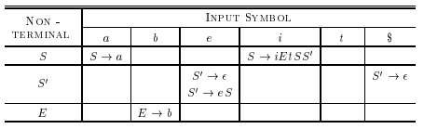
LL (1) Grammars
The following grammar, which abstracts the dangling-else problem,
S→ iEtSS’ | a
S’ →eS | Ɛ
E → b

Slide 34
LL ( 1 ) Parser
Non-Recursive predictive parsing is a table-driven parser.
It is a top-down parser.
Non-Recursive Predictive Parsing is also known as LL(1) Parser.
Parsing Table input buffer :
Our string to be parsed. We will assume that its end is marked with a special symbol $.
Output: a production rule representing a step of the derivation sequence (left-most derivation) of the string in the input buffer.

Slide 35
LL ( 1 ) Parser
Stack :
Contains the grammar symbols
At the bottom of the stack, there is a special end marker symbol $.
Initially the stack contains only the symbol $ and the starting symbol S. ($S<-initial stack)
When the stack is emptied (i.e. only $ left in the stack), the parsing is completed

Slide 36
LL ( 1 ) Parser
Parsing Table:
A two-dimensional array M[A,a]
Each row is a non-terminal symbol
Each column is a terminal symbol or the special symbol $
Each entry holds a production rule.

Slide 37
LL ( 1 ) Parser
Parser Action:
The symbol at the top of the stack (say X) and the current symbol in the input string (say a) determine the parser action. There are four possible parser actions.
• If X and a are $- > parser halts (successful completion)
• If X and a are the same terminal symbol (different from $) ->parser pops X from the stack, and moves the next symbol in the input buffer.

Slide 38
LL ( 1 ) Parser
Parser Action:
• If X is a non-terminal
• parser looks at the parsing table entry M[X,a]. If M[X,a] holds a production rule X→Y1Y2...Yk, it pops X from the stack and pushes Yk,Yk-1,...,Y1 into the stack. The parser also outputs the production rule X→Y1Y2...Yk to represent a step of the derivation.
• None of the above- > error – All empty entries in the parsing table are errors. – If X is a terminal symbol different from a, this is also an error case.

Slide 39

LL ( 1 ) Parser
For the Grammar is S → aBa; B → bB | ε and the following LL(1) parsing table:

Slide 40
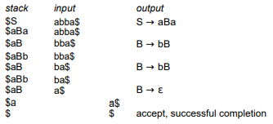
LL ( 1 ) Parser
Outputs: S→aBa B→bB B→bB B→Ɛ

Slide 41
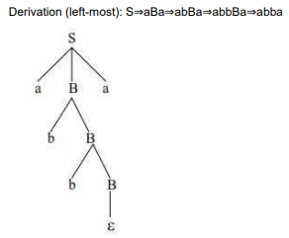
LL ( 1 ) Parser

Slide 42

Non recursive Predictive Parsing
A nonrecursive predictive parser can be built by maintaining a stack explicitly, rather than implicitly via recursive calls. The parser mimics a leftmost derivation. If w is the input that has been matched so far, then the stack holds a
sequence of grammar symbols α such that

Slide 43
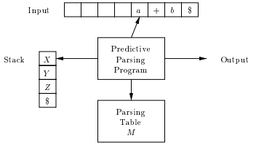
Non recursive Predictive Parsing
Table-driven predictive parsing.
Input: A string w and a parsing table M for grammar G.
Output: If w is in L(G), a leftmost derivation of w, otherwise an error indication.

Slide 44
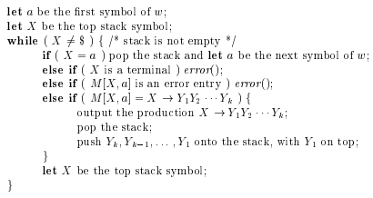
Non recursive Predictive Parsing
METHOD: Initially, the parser is in a configuration with w$ in the input buffer and the start symbol S of G on top of the stack, above $. The program below uses the predictive parsing table M to produce a predictive parse for the input.

Slide 45
CONSTRUCTING LL( 1 ) PARSING TABLE
• Two functions are used in the construction of LL(1) parsing tables -FIRST & FOLLOW
• FIRST(α) is a set of the terminal symbols which occur as first symbols in strings derived from α where α is any string of grammar symbols.
• if α derives to ε, then ε is also in FIRST(α) .
• FOLLOW(A) is the set of the terminals which occur immediately after (follow) the non-terminal A in the strings derived from the starting symbol. – A terminal a is in FOLLOW(A) if S ⇒ αAaβ – $ is in FOLLOW(A) if S ⇒ αA

Slide 46
CONSTRUCTING LL( 1 ) PARSING TABLE
Algorithm for Constructing LL(1) Parsing Table:
• for each production rule A → α of a grammar G
– for each terminal a in FIRST(α)->add A → α to M[A,a]
– If ε in FIRST(α)->for each terminal a in FOLLOW(A) add A → α to M[A,a]
– If ε in FIRST(α) and $ in FOLLOW(A)->add A → α to M[A,$]
• All other undefined entries of the parsing table are error entries.

Slide 47
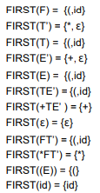


EXAMPLE

Slide 48
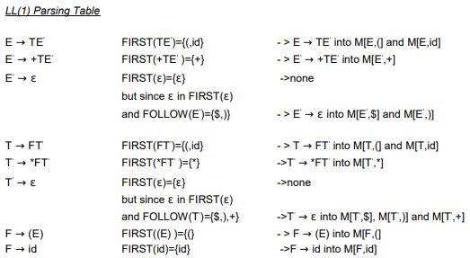
EXAMPLE

Slide 49
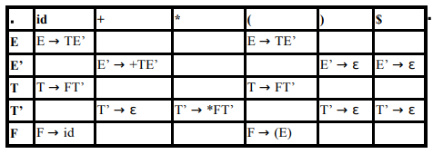
EXAMPLE

Slide 50
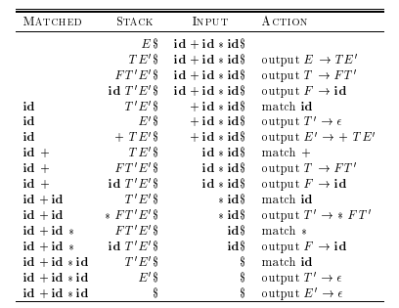
EXAMPLE
Moves made by a predictive parser on input
id + id * id

Slide 51
Thank You

